Slide 1

Symphony
Multi-Mission Software Framework
Presentation to RCM Team
April 14, 2015
Régent L’Archevêque
Pierre Allard
Martin Picard
Notes:
1

Slide 2
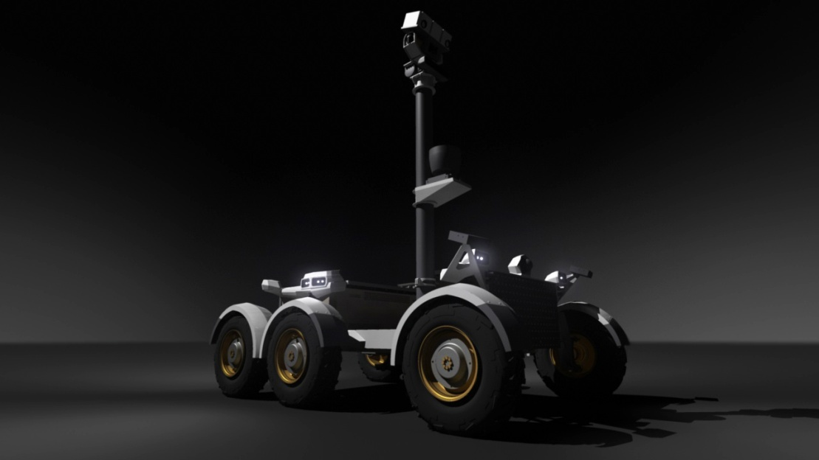
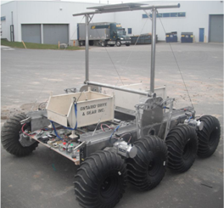
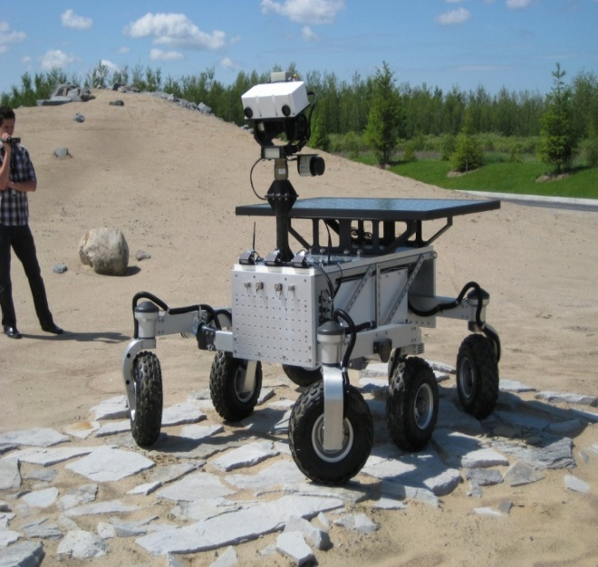
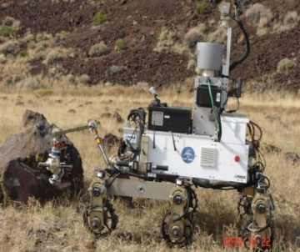
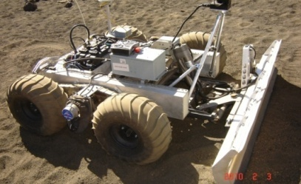
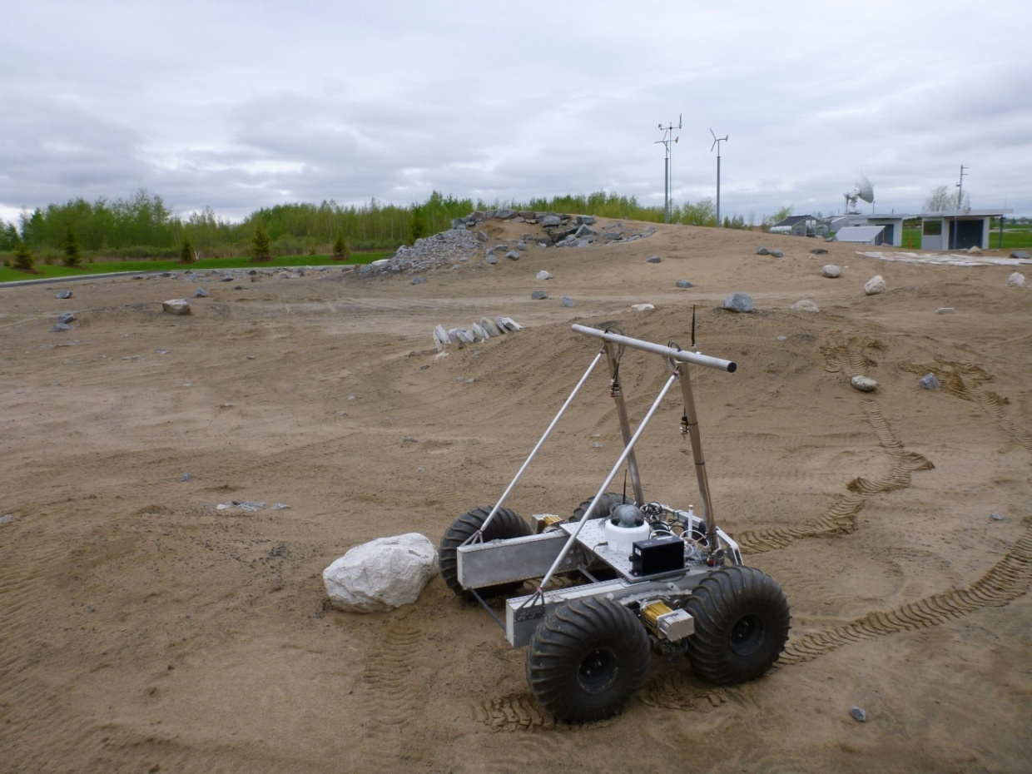
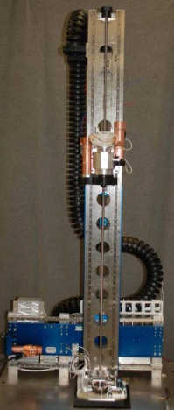
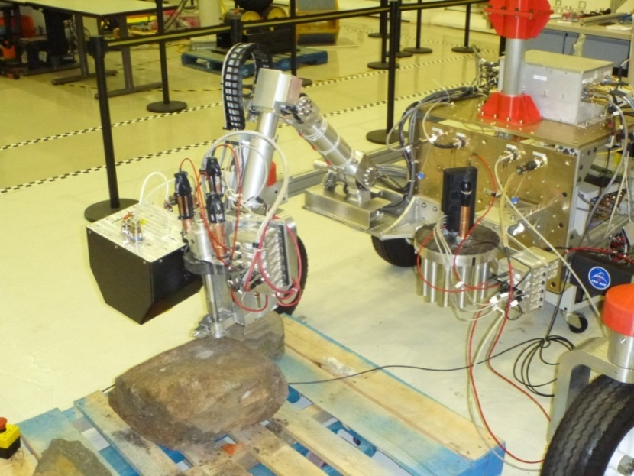
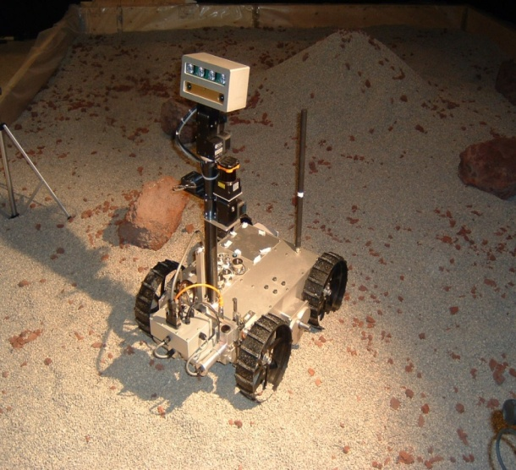
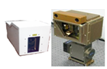

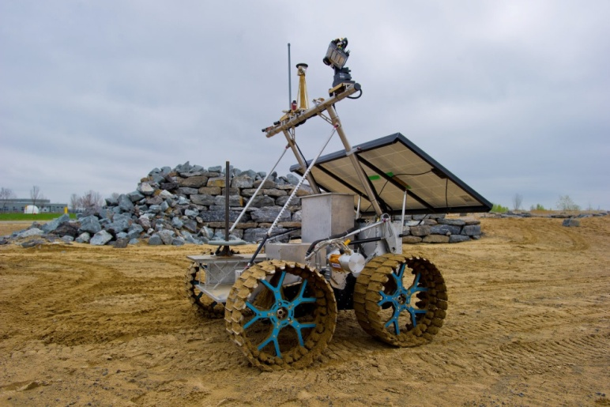
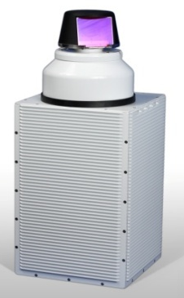
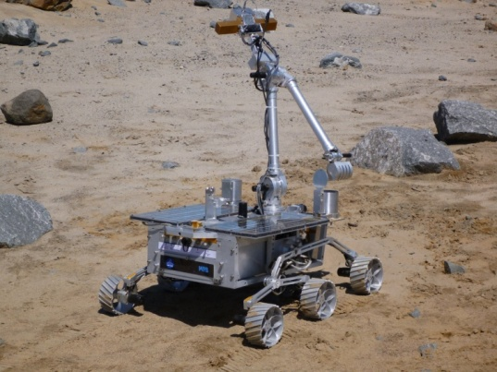
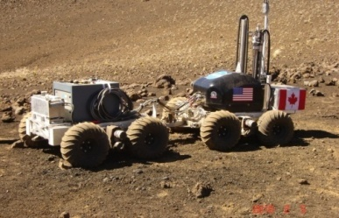
CSA Rovers & Instruments
2

Slide 3

A tool to plan, validate, execute and monitor integrated operations to support multiple missions
A component-based architecture that allows instruments and rovers to “plug-in”
Organizationally neutral core framework
Maximizes reuse between missions
Symphony is NOT a simulator BUT can integrate one

Slide 4
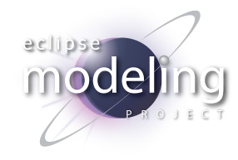









Eclipse Technologies

Slide 5
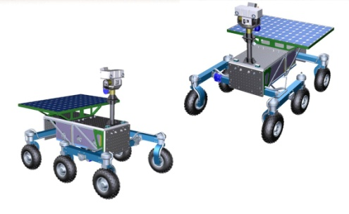
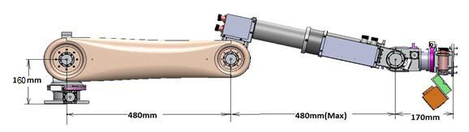
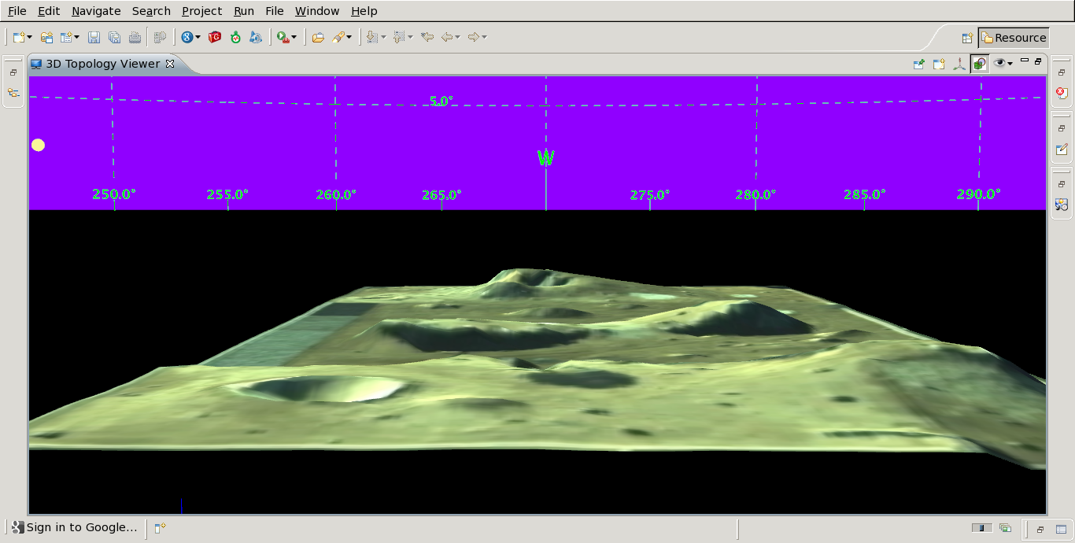
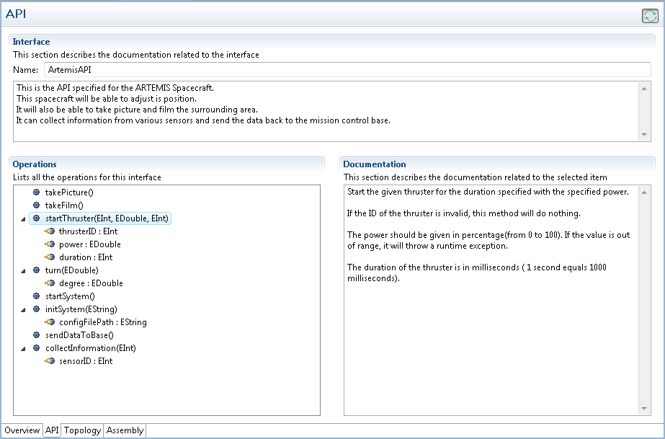







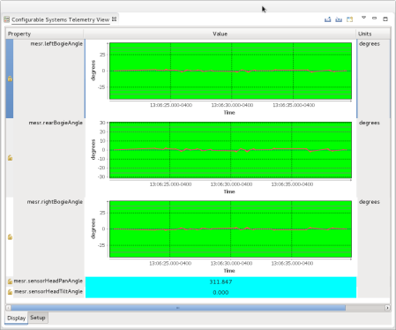
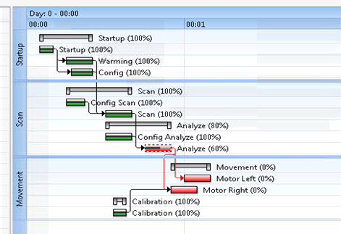

Symphony Concept

Slide 6

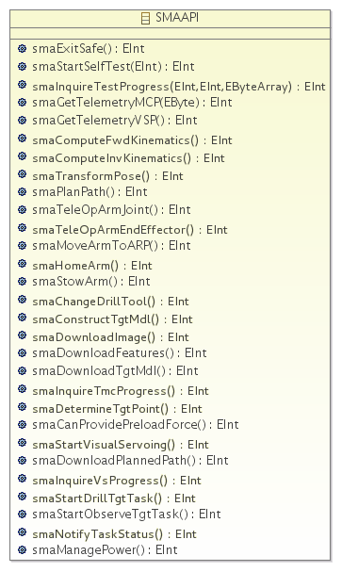
Systems

Slide 7

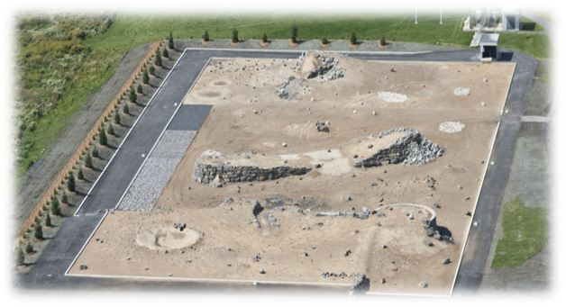
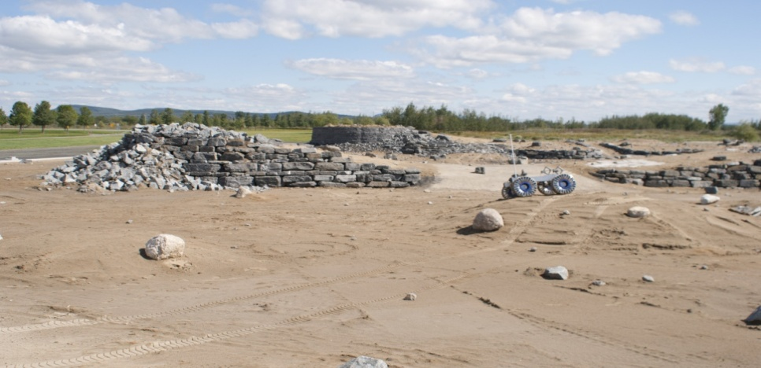
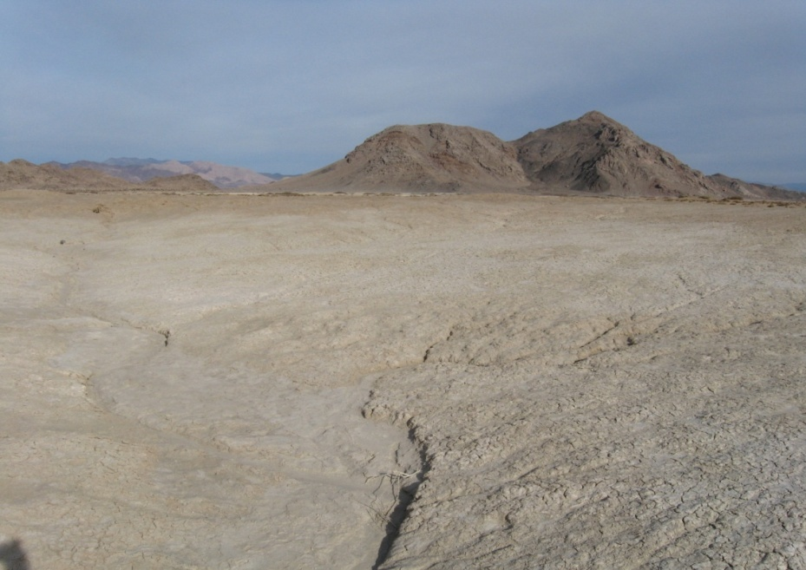
Environment

Slide 8

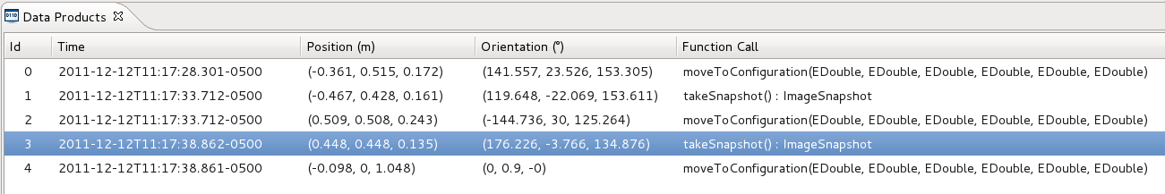
Operations

Slide 9
Symphony Core Capabilities
System
Command
Telemetry
Environment
Surface Worksite
Orbital Worksite
Operations
3D Model
Assembly
Hand-Controllers
Ops Contexts
Resources Modeling
Data Products
Scripts
Distributed Collaboration

Slide 10
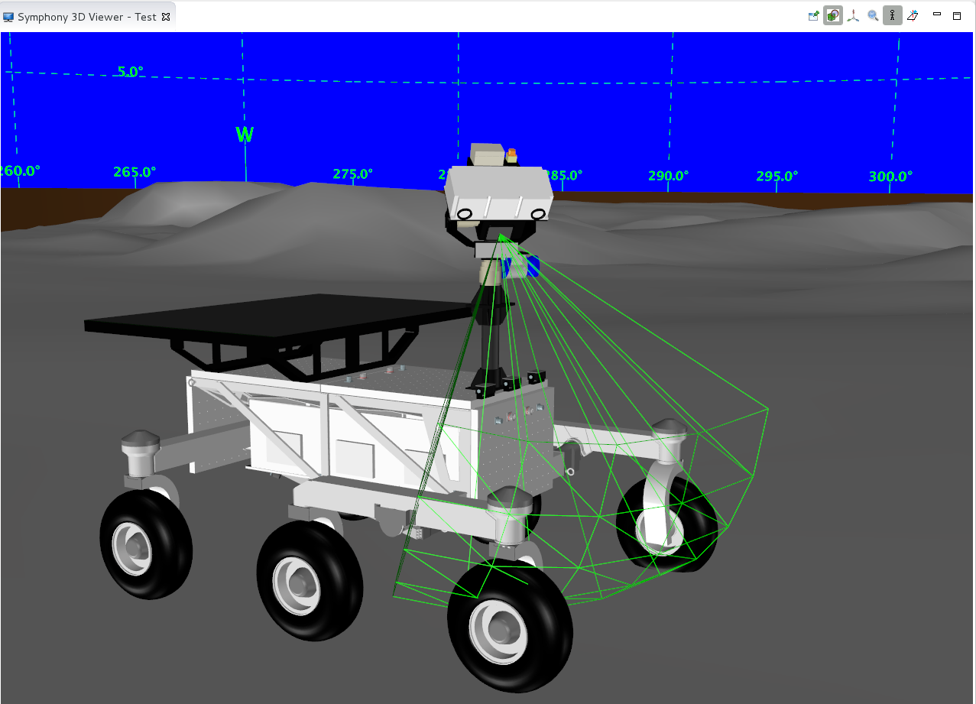
MESR 3D Model

Slide 11
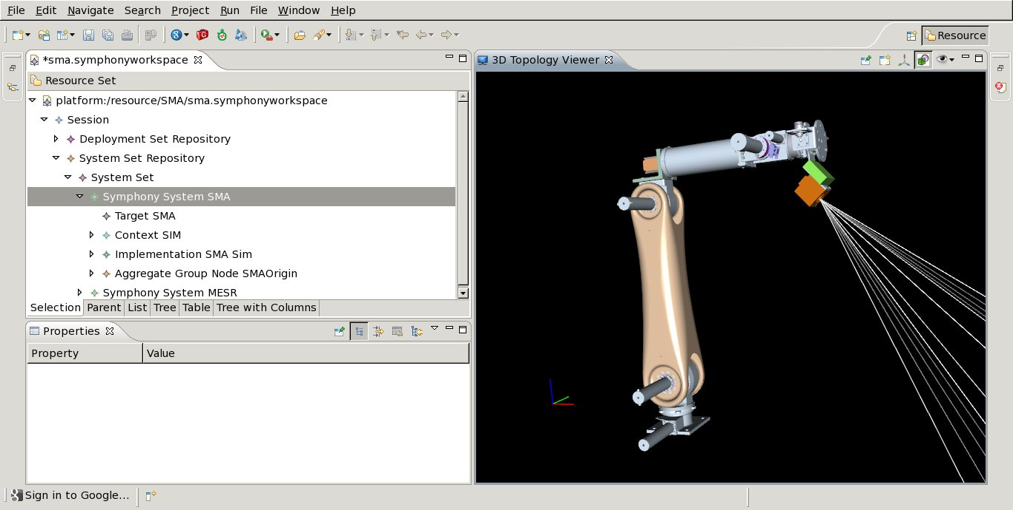
Planetary Medium Manipulator

Slide 12
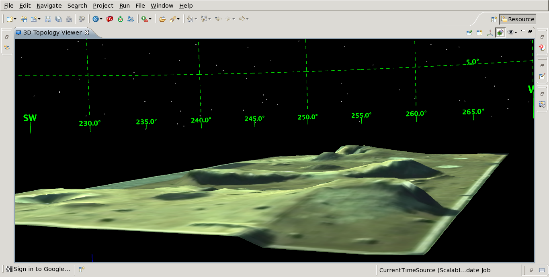
Environment Modeling

Slide 13
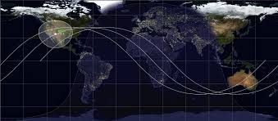
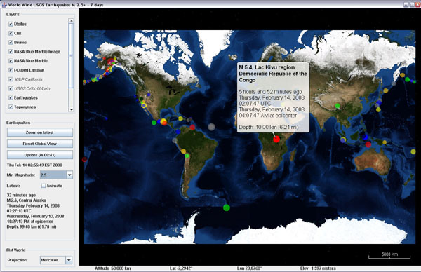
Orbital Mechanics
Symphony leverages ESA OreKit & NASA World Wind Toolboxes

Slide 14
Plan Execution & Monitoring

Slide 15
IP
CSA Applications (CSA)
Industry & Academia Applications
Symphony (CSA)
CSA Libraries (CSA)
Off The Shelf (EPL, Apache, no GPL)
Eclipse SDK (EPL)

Slide 16
Applications & Users
Symphony
Core
CSA Analogue Deployments
ODG - SPRP
Neptec Artemis Jr
GHGSat
MDA TEMMI
MSS Demonstrations
Neptec LiNIS & RNLS
EML2 Concepts & Demos
MPB LIRA
Academia Projects

Slide 17
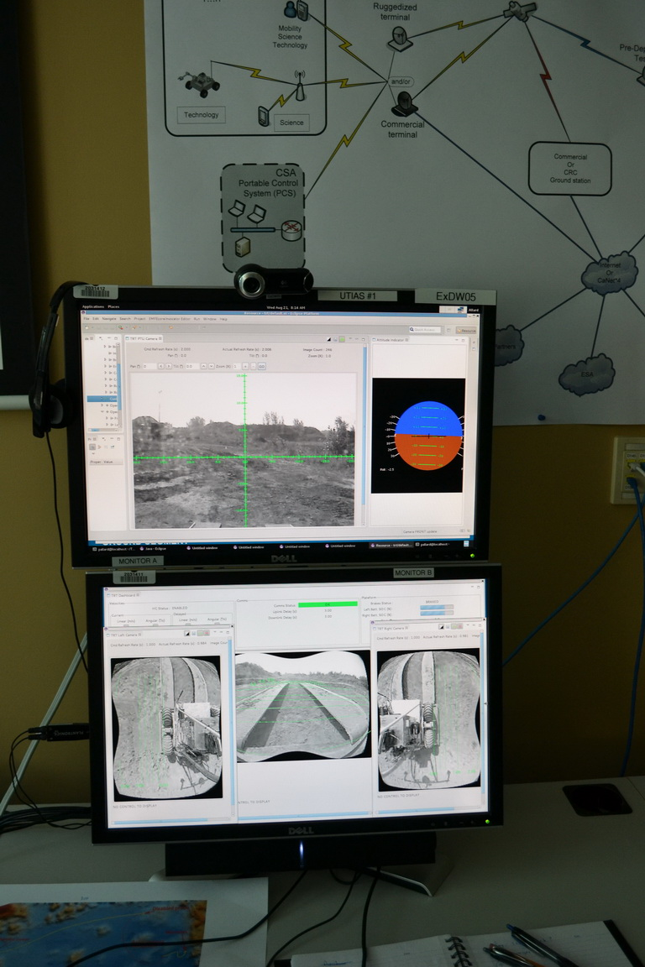
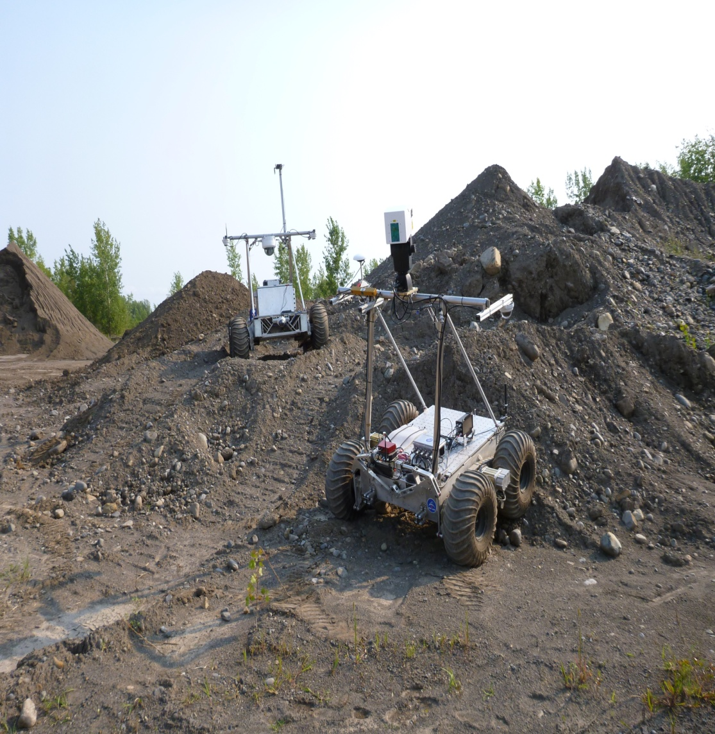
Mercier 2013 Deployment

Slide 18
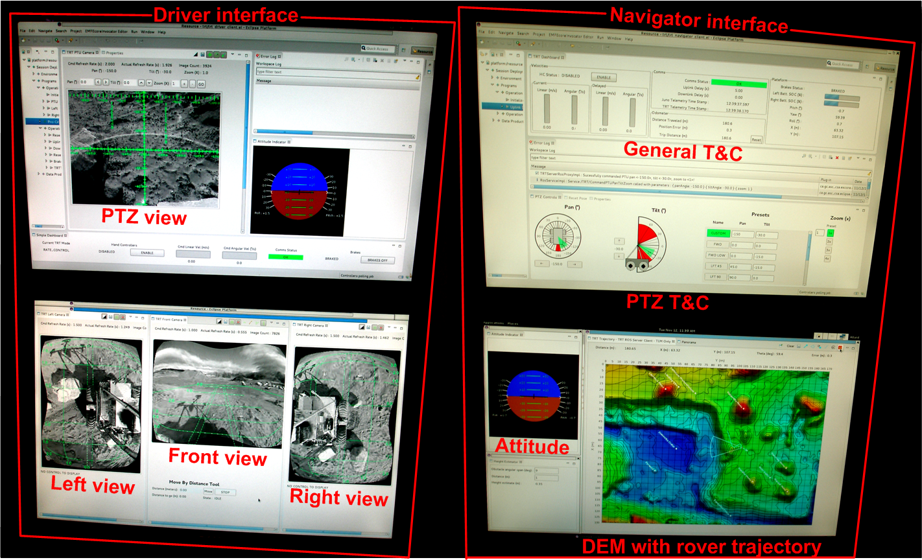
Deployments 2014

Slide 19
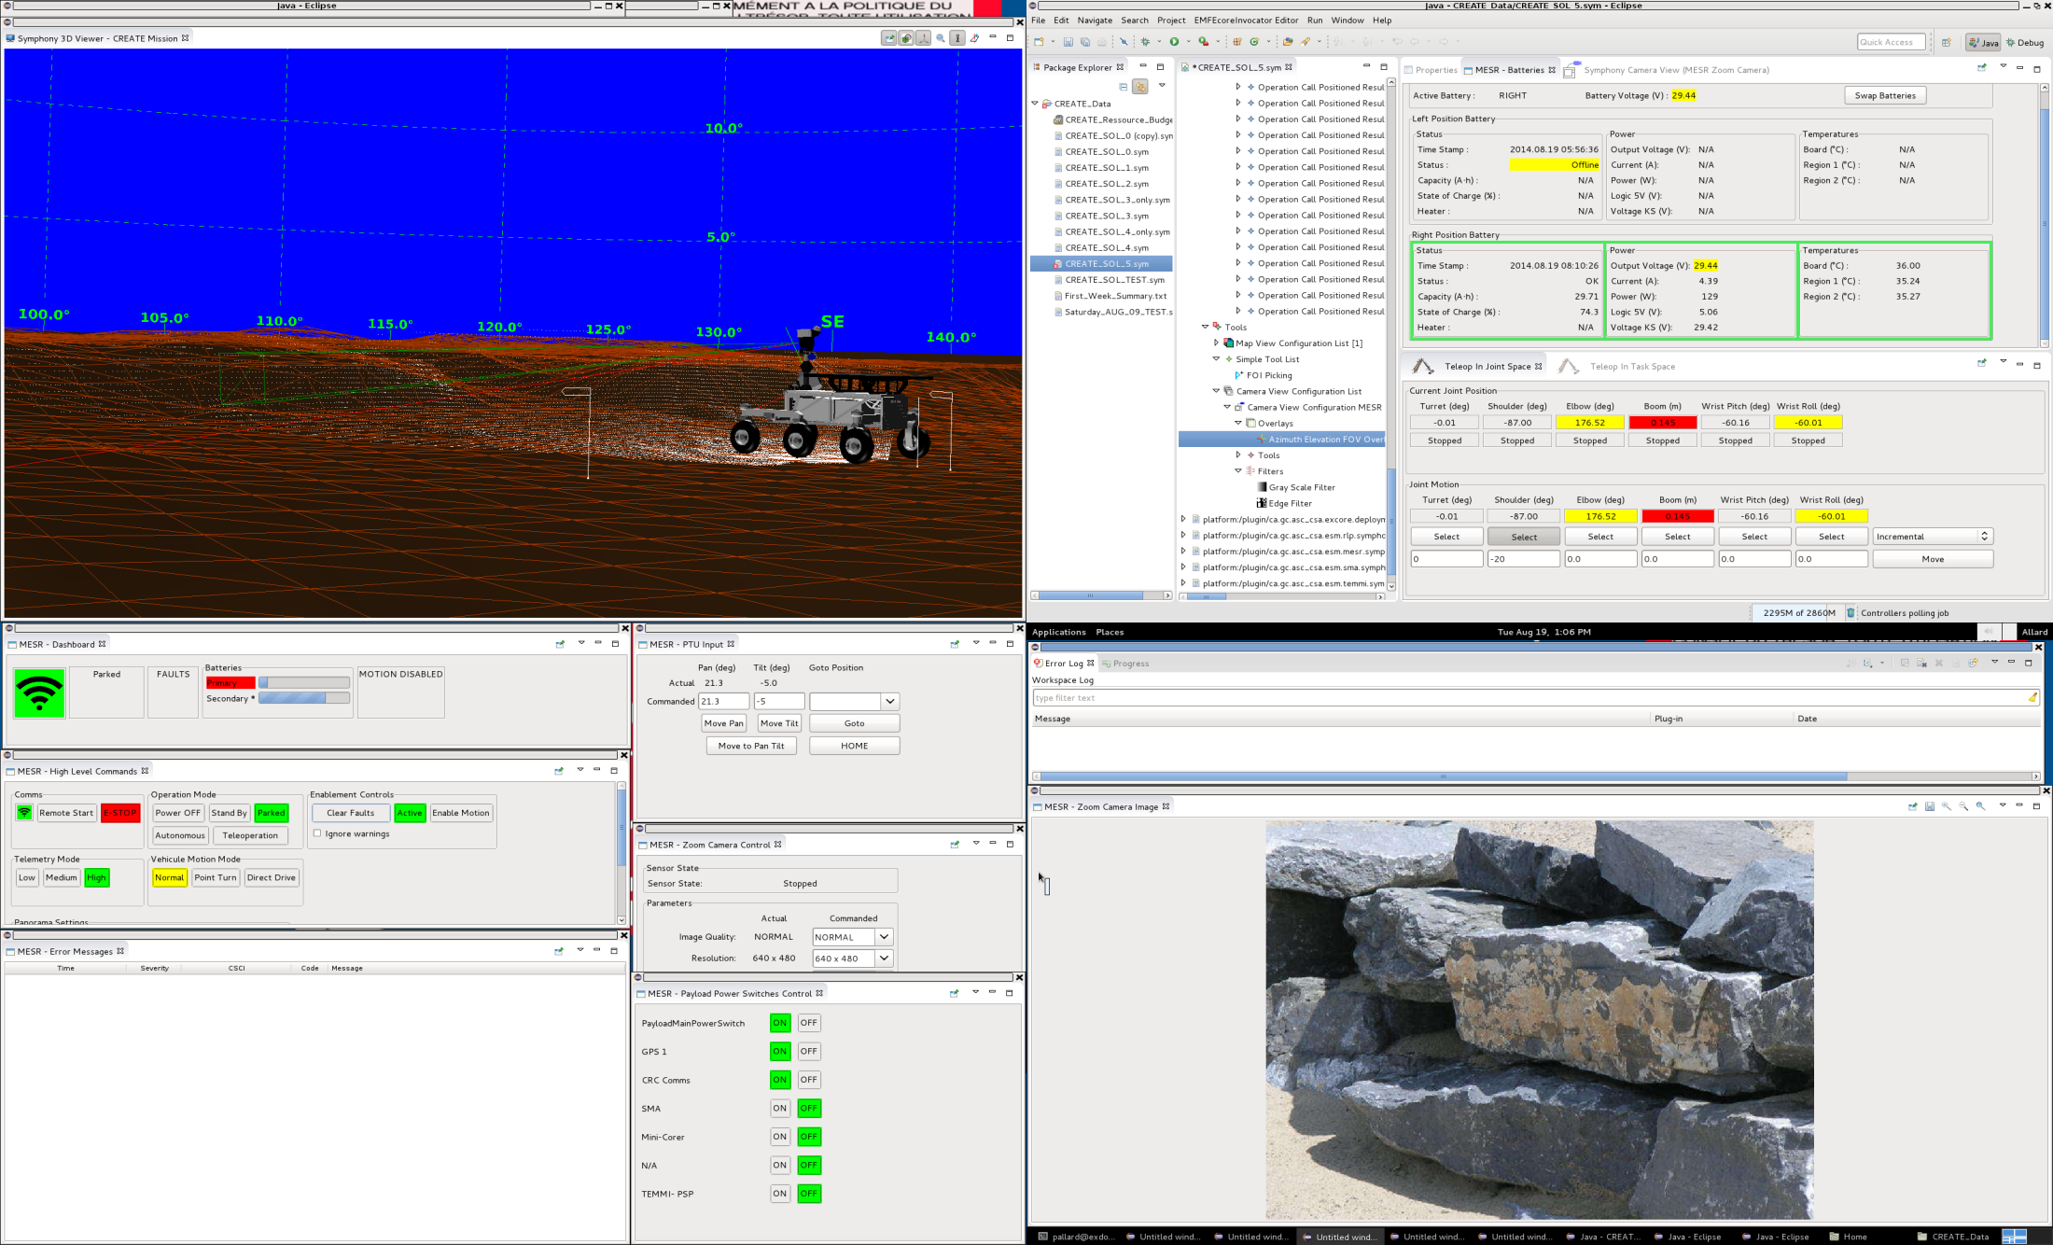
Deployments 2014

Slide 20
Next Big Steps
Release Open-Source Symphony
Conduct Symphony Scripting Project
Distributed Collaboration Integration

Slide 21
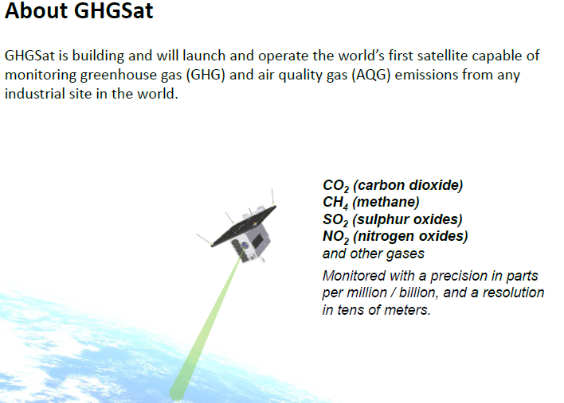
GHGSat Opportunity
GHGSat Inc. (Xiphos) contacted CSA to use Symphony for operations of its Spectrometer & Hyperspectral camera, meeting Jan 26th at Xiphos
15 Kg Nanosat
Launch Fall 2015
GS ready Jul 2015
Spectrometer & hyperspectral camera plds
Plan
Validate
Execute
Monitor

Slide 22

Summary
One integrated mission operation tool
Fast operation planning & analysis
Re-usable and extendable framework

